Slide 1
Predicting the Financial Success of Movies
By Jeffrey Wang

Slide 2
Introduction and Motivation
Box office
Word of mouth
46% of total sales from movie tickets generated within first week of release

Slide 3
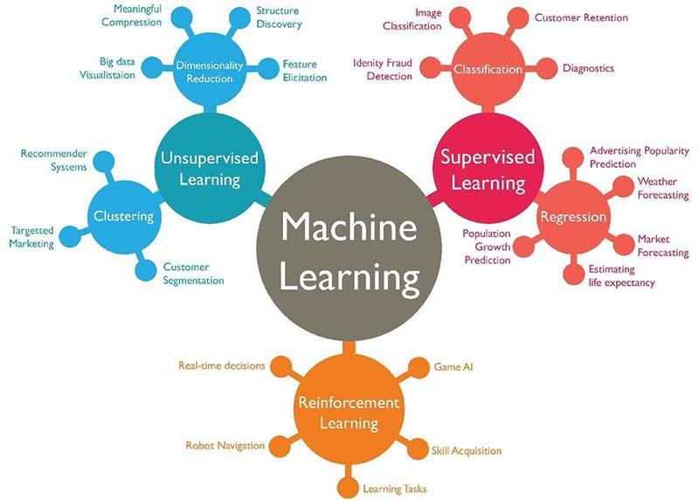
Machine Learning
Learn automatically without explicit programming
Types: supervised, unsupervised, reinforcement learning
Many projects and libraries (e.g. scikit-learn)

Slide 4
Building a Movie Dataset
Two input variables: ratings and budgets
One target variable: classification (success or flop)
MovieLens: provides ratings
The-numbers website: provides budgets and total revenue

Slide 5
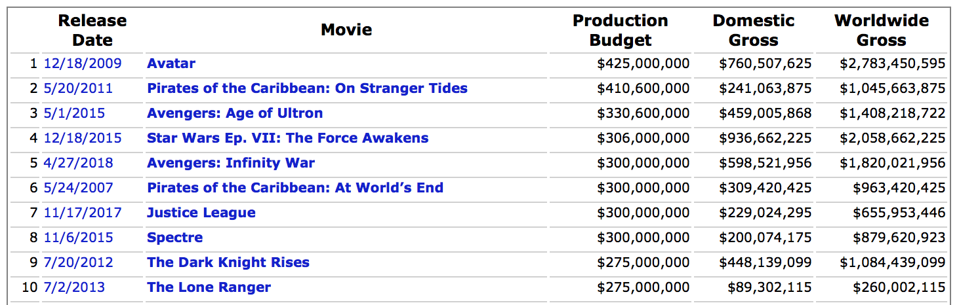
Using Web Scraping
Extract data from websites and store locally on computer
Used BeautifulSoup and Urllib libraries
Fetch URLs to load webpages, then search through HTML tags

Slide 6
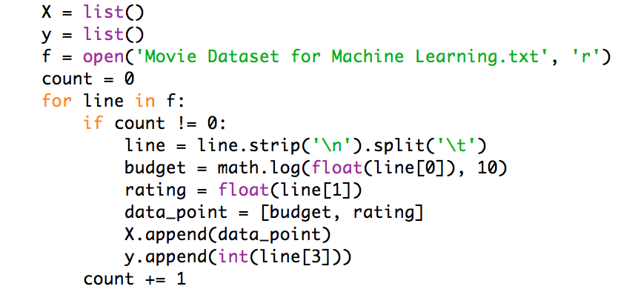
Making Predictions - Part 1
Read in dataset from text file into Python program
Transform data: take logarithm of budget numbers
Use two lists: one for input variables and one for target variable

Slide 7
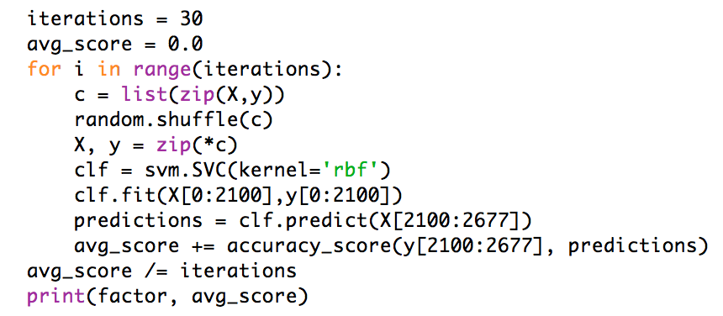
Making Predictions - Part 2
Choose classifier: RBF SVM
Randomly select 80% of dataset for training
Classifier predicts on other 20%
Test out factor scaling (30 trials each)

Slide 8
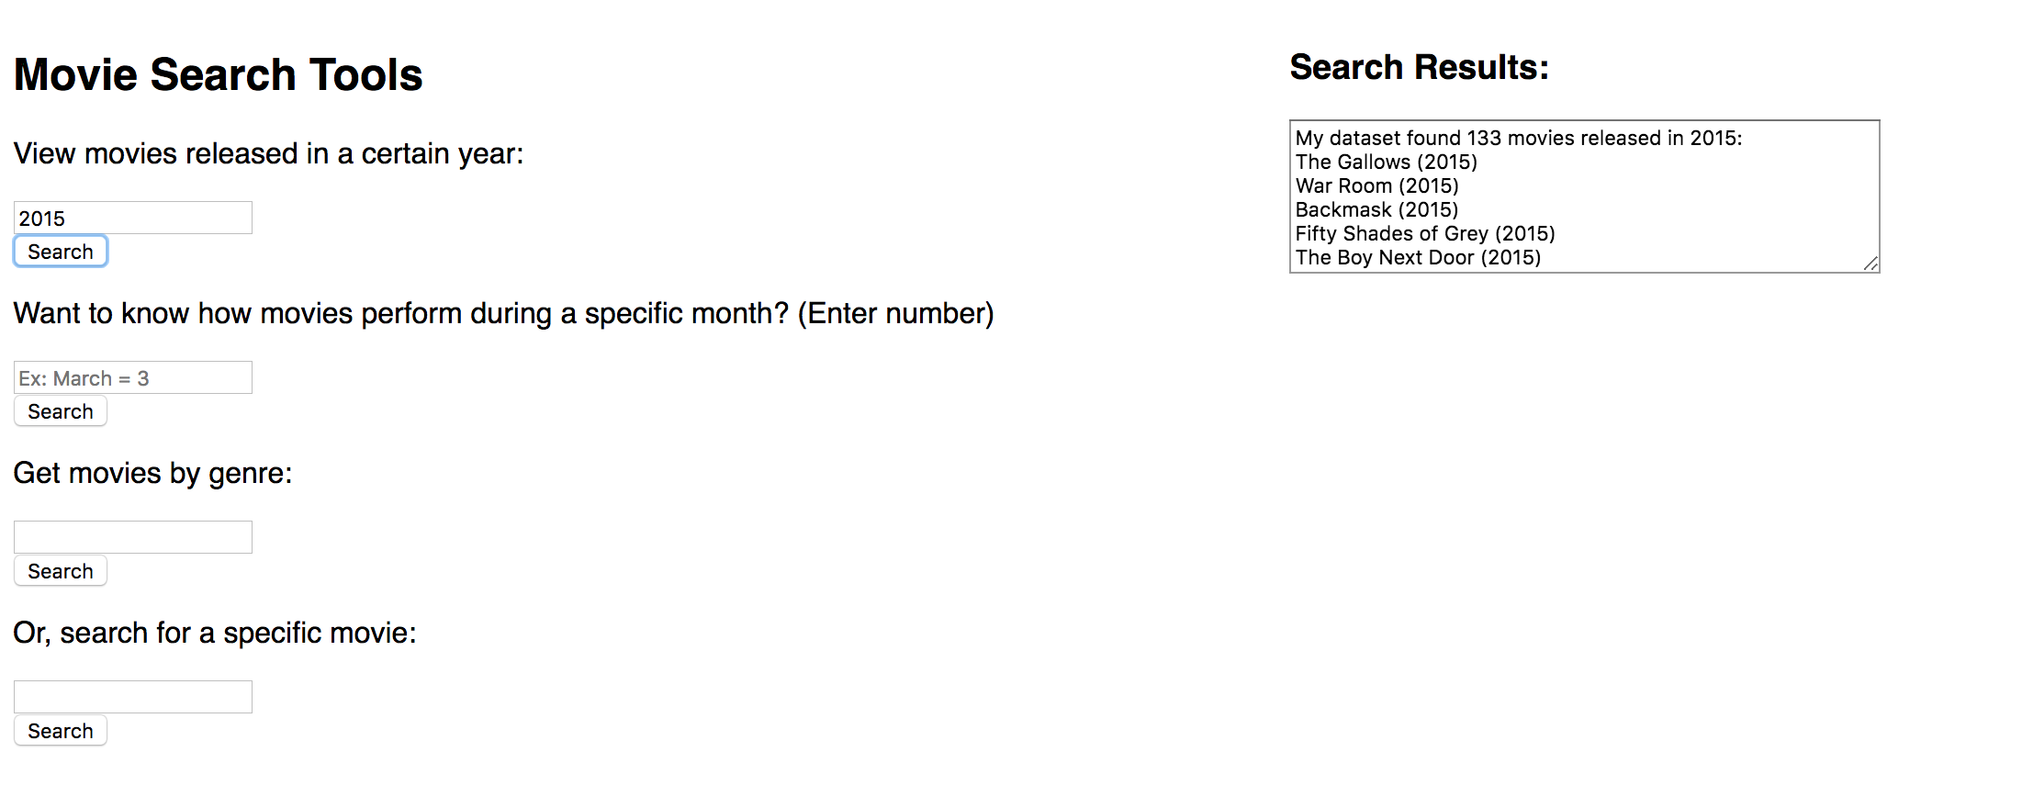
Website Supplement - Search Tools

Slide 9
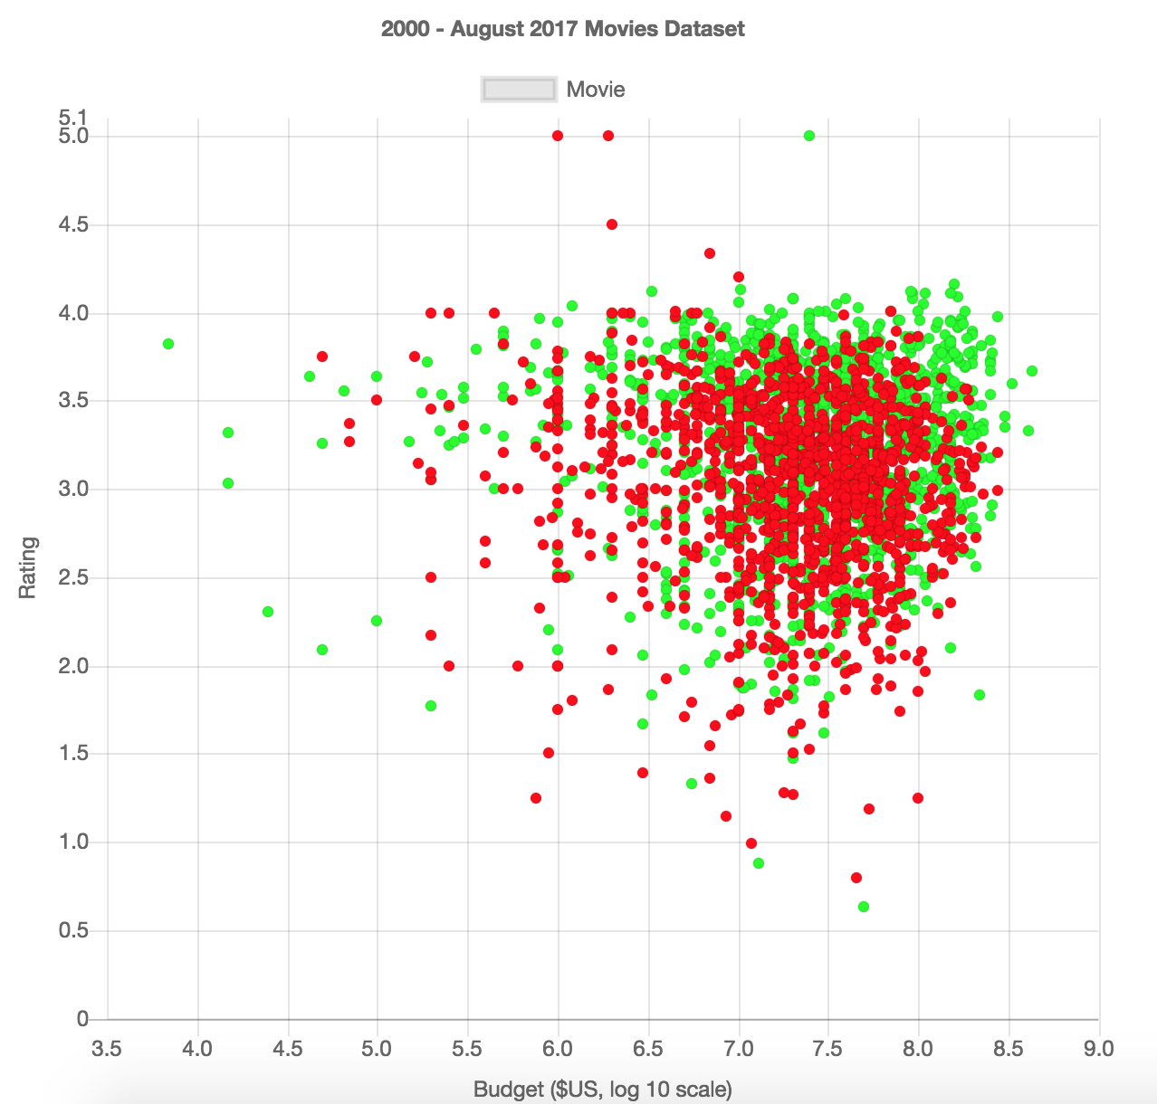
Website Supplement - Dataset Display

Slide 10
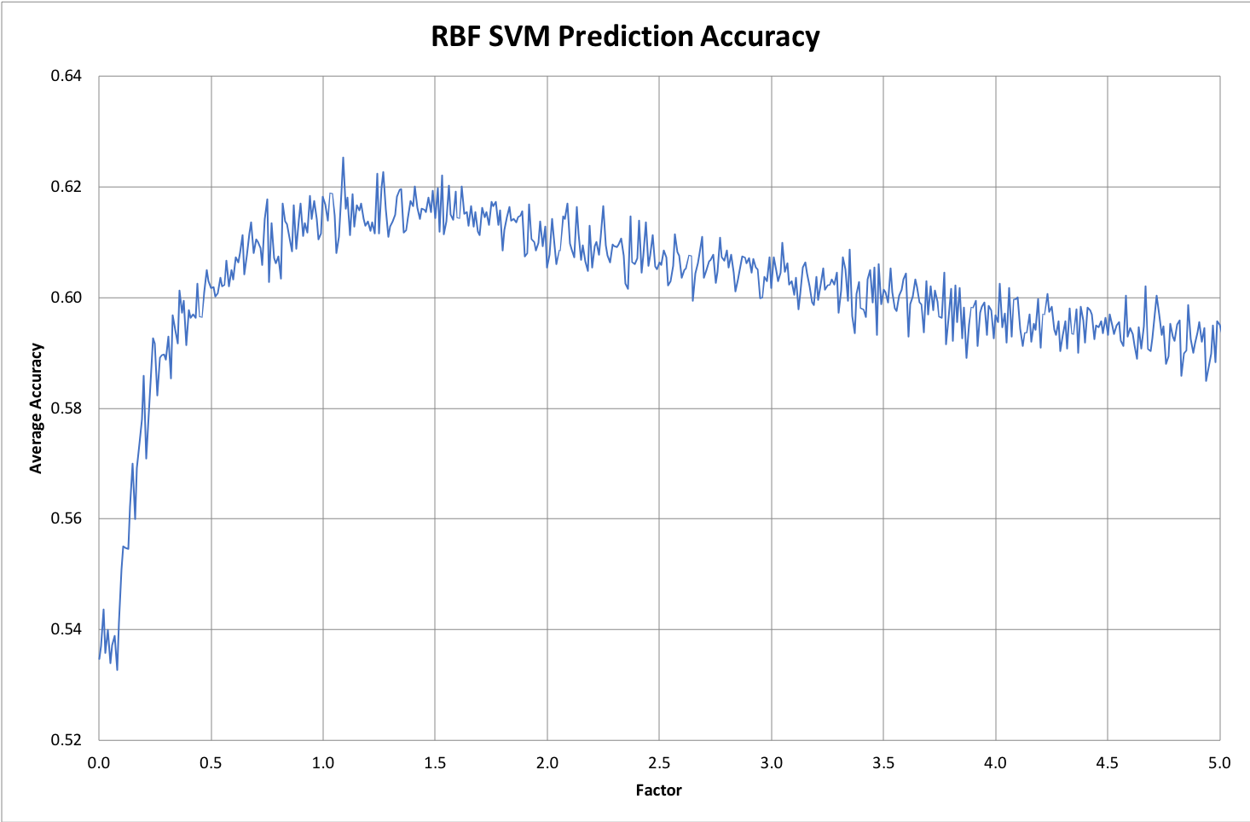
Results

Slide 11
Conclusion
62%: some degree of accuracy
Area of success, but otherwise noisy
Further considerations: sentiment analysis

Slide 12
Thanks!
Any questions?

